Slide 1
Project Presentation of CO-OP Project at Industry (Module-2) (22CS421)
On
Heart Disease Prediction System
Harmanavjeet Singh
2210990369
Supervised By
Mr. Gurpreet Singh
Department of Computer Science and Engineering,
Chitkara University, Punjab

Slide 2
Introduction
1. Cardiovascular Disease
Heart disease includes various conditions affecting the heart and blood vessels, such as coronary artery disease, stroke, and heart failure.
2. Risk Factors
Modifiable risk factors include smoking, high cholesterol, high blood pressure, and lack of physical activity.
3. Early Detection
Early detection and treatment can significantly improve outcomes and reduce the risk of complications.
2

Slide 3
Background Work
Logistic Regression is effective in predicting heart disease from clinical data, often used for binary classification.
Decision Trees and Random Forests are popular for their interpretability and high accuracy in identifying complex patterns in patient data.
XGBoost and AdaBoost enhance performance by combining classifiers, reducing overfitting, and improving precision.

Slide 4
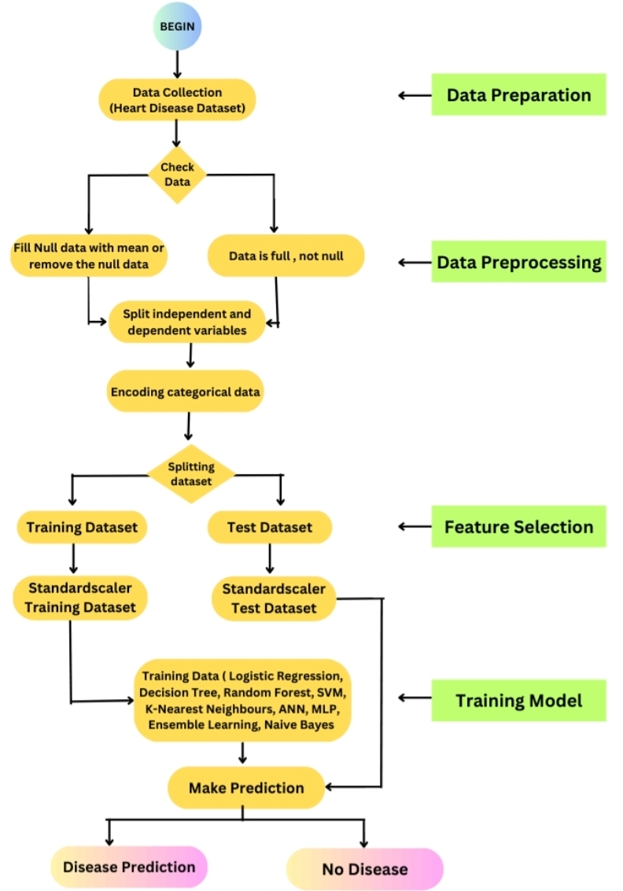
Methodology Diagram

Slide 5
Data Collection and Preprocessing
1. Data Source
Data is collected from the Cleveland Heart Disease dataset from the University of California, Irvine (UCI) Machine Learning Repository.[3]
2. Data Cleaning
Missing values are handled, inconsistent data is corrected, and outliers are identified and addressed.
3. Data Transformation
Variables are scaled or normalized to ensure consistency and improve model performance.

Slide 6
Dataset Description
The dataset [3] includes the following features:
age: Age of the patient.
sex: Gender of the patient (0: female, 1: male).
cp: Type of chest pain - 0: Typical angina , 1: Atypical angina, 2: Non-anginal pain, 3: Asymptomatic
trestbps: Resting blood pressure in mmHg.
chol: Serum cholesterol level in mg/dL.
fbs: (Fasting blood sugar > 120 mg/dl): 1 if true, 0 if false.
restecg: Resting electrocardiographic results- 0: Normal, 1: ST-T wave abnormality (indicating potential heart disease), 2: Probable or definite left ventricular hypertrophy
thalach: Maximum heart rate achieved.
exang: Exercise induced angina. 1 if the patient experiences angina with exercise, 0 if not.
oldpeak: ST depression induced by exercise relative to rest.
Thal: Thalassemia Blood Disorder- 1: Normal, 2: Fixed defect, 3:Reversible defect
Target: The outcome label indicating the presence of heart disease: 0: No heart disease 1: Heart disease

Slide 7
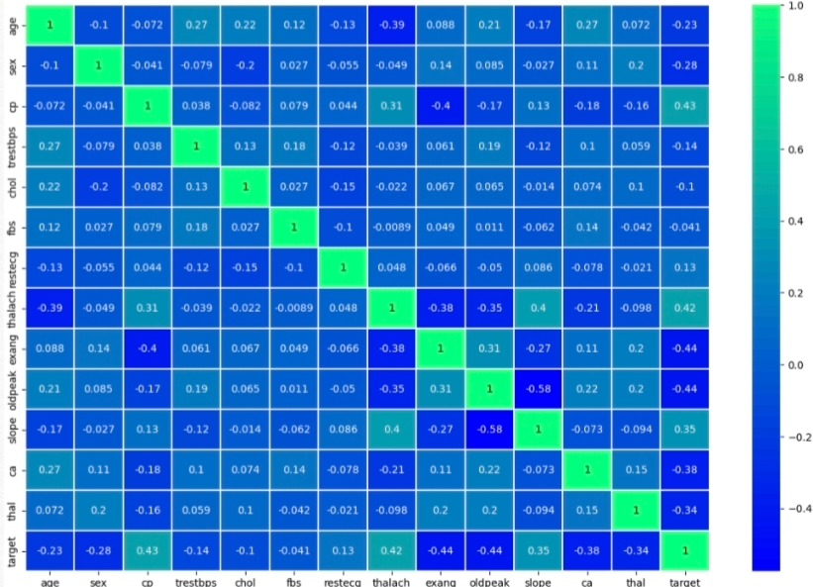
Correlation Heatmap

Slide 8
Machine Learning Models Explored
Logistic Regression : A well-known model for binary classification that shows how different features relate to heart disease risk. [1]
Decision Tree : A rule-based model that makes it easy to understand feature importance and decision paths beneficial for identifying key risk factors. [1] [2] [4]
Random Forest : An ensemble of decision trees that provides high accuracy and reduces overfitting. [2]
Support Vector Machines (SVM) : Effective when dealing with non-linearly separable data. [1] [2] [4]
K-Nearest Neighbours : Works well in cases with a smaller dataset, useful for quickly identifying patterns in patient risk. [1] [2]
Artificial Neural Networks (ANN) and Multi-Layer Perceptron(MLP) : Able to learn complex patterns in large datasets, capturing nuanced risk factors in patient data. [5]
Ensemble Learning (Gradient Boosting, AdaBoost, XGBoost) : These provide strong classification accuracy, particularly useful when combining weak learners for an optimal result. [2]
Naive Bayes : A probabilistic approach that's efficient for smaller datasets and provides quick, interpretable results. [1] [2] [4]

Slide 9
Model Evaluation and Comparison
1. Accuracy :
TP+TN
TP+FP+FN+TN
2. Precision :
TP
TP+FP
3.Recall :
TP
TP+FN
4. F1-Score :
2 X (Recall X Precision)
Recall + Precision

Slide 10
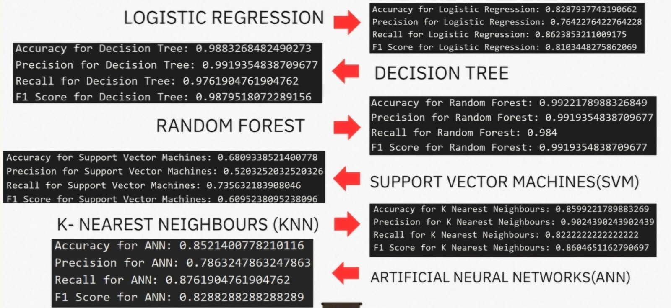
Classification Report

Slide 11
Future Enhancements
1.The research involves comparative analysis of various machine learning models to identify the most effective one based on accuracy and key performance metrics.
2. Development of an interactive application that will help clinicians to make informed decisions.
3. Development of an interactive dashboard that will automatically update with the new data. The dynamic visualizations will allow to filter data by gender, age and specific risk factors, making easier for clinicians to take decisions.

Slide 12
References
[1] Anderies, A., Tchin, J. A. R. W., Putro, P. H., Darmawan, Y. P., & Gunawan, A. A. S. (2022). Prediction of heart disease UCI dataset using machine learning algorithms. Engineering, Mathematics and Computer Science (EMACS) Journal, 4(3), 87–93. https://doi.org/10.21512/emacsjournal.v4i3.8683
[2] Srinivasan, S., Gunasekaran, S., Mathivanan, S. K., et al. (2023). An active learning machine technique based prediction of cardiovascular heart disease from UCI-repository database. Scientific Reports, 13, 13588. https://doi.org/10.1038/s41598-023-40717-1
[3] Cleveland Heart Disease Dataset available at: https://archive.ics.uci.edu/dataset/45/heart+disease
[4] Singh, A., & Kumar, R. (2020). Heart disease prediction using machine learning algorithms. In 2020 International Conference on Electrical and Electronics Engineering (ICE3) (pp. 452–457). IEEE. https://doi.org/10.1109/ICE348803.2020.9122958
[5] Purushottam, Saxena, K., & Sharma, R. (2016). Efficient heart disease prediction system. Procedia Computer Science, 85, 962–969. https://doi.org/10.1016/j.procs.2016.05.288

Slide 13
Thank You
13

